Slide 1









#HLFC2023
#222MillionDreams :
Delivering on Our Promise
Visibility Guidance Webinar
@EduCannotWait
/EduCannotWait
@EduCannotWait
@EduCannotWait
Education Cannot Wait
Education Cannot Wait

Slide 2

























What is ECW?
#222MillionDreams #HLFC2023
Education Cannot Wait (ECW) is the United Nations global fund for education in emergencies and protracted crises hosted by UNICEF.
Together with our strategic partners, ECW supports and protects inclusive and holistic learning outcomes for refugee, internally displaced and other crisis-affected girls and boys, so no one is left behind.
ECW urgently appeals to public and private sector donors for additional funding to reach even more crisis-affected children and youth caught in armed conflicts, forced displacement, climate-change induced disasters and protracted crises.
$1.1B ECW Trust Fund and over $1B in-country leveraged funds
HLSG Members – May 2022

Slide 3
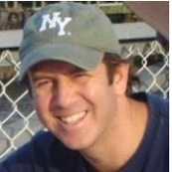

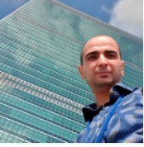
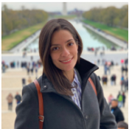

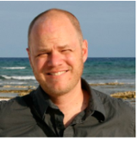
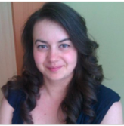
#222MillionDreams #HLFC2023
Meet the ECW Advocacy/Comms Team
Kent Page
Chief
Advocacy and Communications
kpage@unicef.org
@KentPage
Anouk Desgroseilliers
Manager
Advocacy and Communications
adesgroseilliers@unicef.org
@Anouk_Des
Bahaa Elias
Communications Consultant
Advocacy and Communications
belias@unicef.org
@Belias87
Estefanía Jiménez
Digital Media Officer
Advocacy and Communications
ejimenez@unicef.org
@Estefjp
Jelena Borak
Associate
Advocacy and Communications
jborak@unicef.org
@Jelena_Borak
Today
Greg Benchwick
Communications Consultant
Advocacy and Communications
gbenchwick@unicef.org
@GregBenchwick
Victoria Mullin
Administrator
Advocacy and Communications
vmullin@unicef.org
@VMullin1985

Slide 4





#222MillionDreams #HLFC2023
Webinar Run of Show: Delivering on Our Promise
Introduction to ECW’s Advocacy and Comms
#222MillionDreams
Campaign
Visibility Guidance Note, Brand Guidelines and ECW Visibility
Group Discussion &
Next Steps

Slide 5
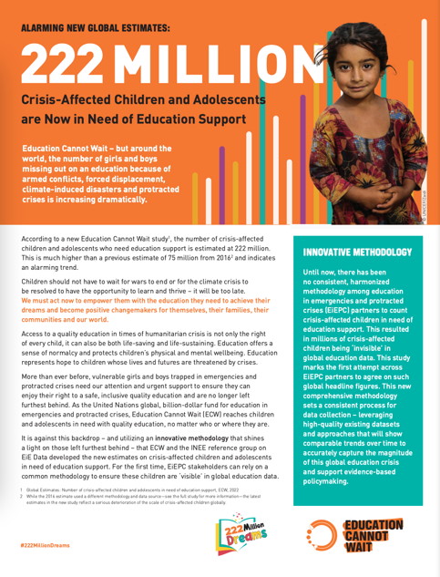





#222MillionDreams Campaign
16-17 February 2023
#222MillionDreams #222MillionsDeRêves #222MillonesDeSueños #222_مليون_حلم
Geneva, Switzerland
New ECW Report: 222 million crisis-affected children & youth are in need of educational support today.
The #222MillionDreams Campaign aims to shine a light on them, their dreams & critical EiEPC financing needs ahead of ECW’s 2023 High-Level Financing Conference.
Campaign Dates:
21 June 2022 – February 2023
ECW’s
High-Level Financing Conference
Co-hosted by ECW & Switzerland
Co-convened by Germany, Niger,
Norway & South Sudan
#222MillionDreams #HLFC2023

Slide 6
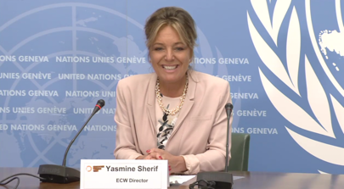


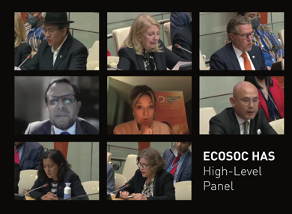




#222MillionDreams Campaign
Campaign Launch
Social Media Kit
Our Reach So Far
Future Key Dates
International & national media coverage (Newsweek, El Pais, VOA, etc.)
More than 1.4 billion potential readers!
Over 40 videos and official statements in support of the Campaign’s launch.
During its first week , the Campaign reached a potential audience of 63 million users across various social channels such as Twitter, Facebook, Instagram, LinkedIn and TikTok.
12 August: International Youth Day/ #Youth4EiEPC
19 August: World Humanitarian Day(#ARR2021)
9 September: International Day to Protect Education from Attack
14-30 September: UNGA weeks
  Launch of ECW Strategic Plan & Case for Investment
  Transforming Education Summit
  Global Citizen Live Concert
5 October: World Teachers Day
11 October: International Day of the Girl
October: Building Bridges Summit
7-18 November: COP27
20 November: Universal Children’s Day
January 2023: International Education Day
16-17 February 2023: ECW HLFC 2023
Quote Cards
UN Press Conference
Video Statements
ECOSOC HAS HL Panel
#MyDream Stories
Launch of ECW Study
Website Landing Page
Notes:
Campaign assets and highlights so far (and what's to come...)

Slide 7

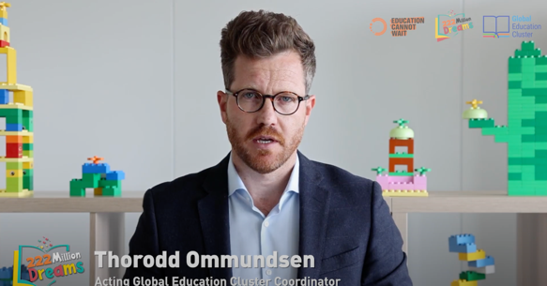


How to Engage?
#222MillionDreams #HLFC2023
1. Personalize your own quote cards
2. Send your video statements
3. Share your stories from the field
4. Join the Campaign!
Use our ready-to-go social pack with messaging
and graphics. The pack is constantly updated with new assets from partners across the globe
Download here

Slide 8


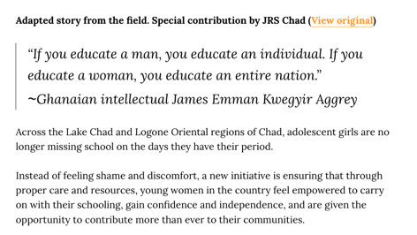

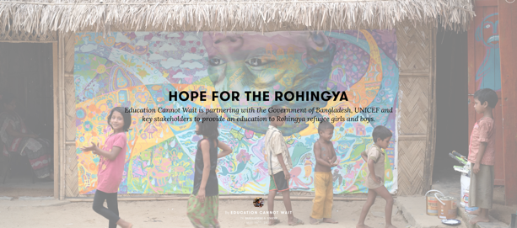
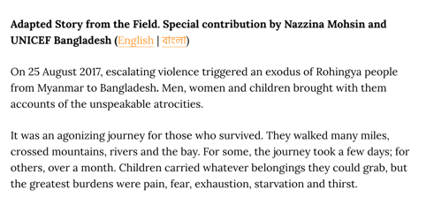
#MyDream Stories
#MyDream #MonRêve #MiSueño #حلمي

Slide 9
#MyDream Stories
#MyDream #MonRêve #MiSueño #حلمي
Share your story
Do you have a story to share on how ECW’s support is making a difference where you are?
We would love to hear from you!
Please send your story:
stories@un-ecw.org

Slide 10



Visibility Guidance Note
#222MillionDreams #HLFC2023
Today
Download here
10

Slide 11
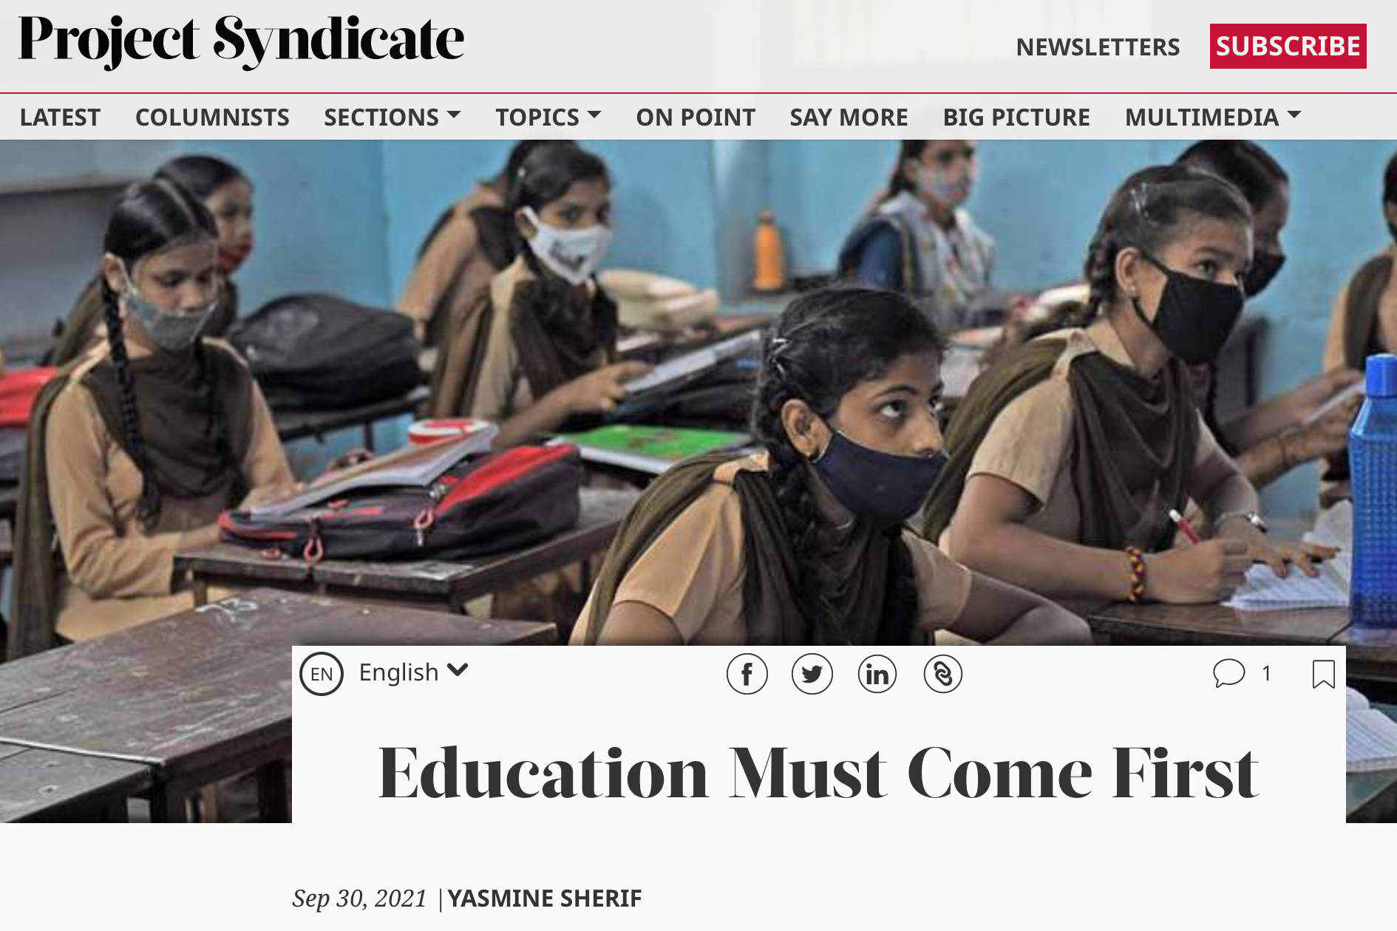
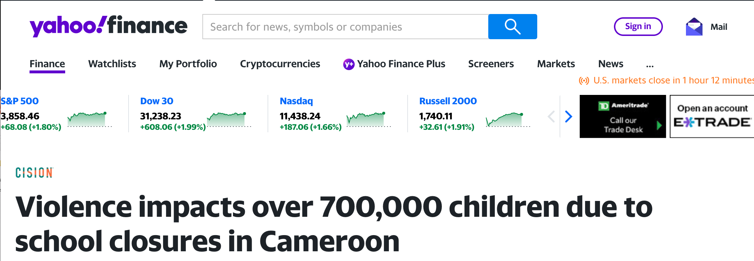
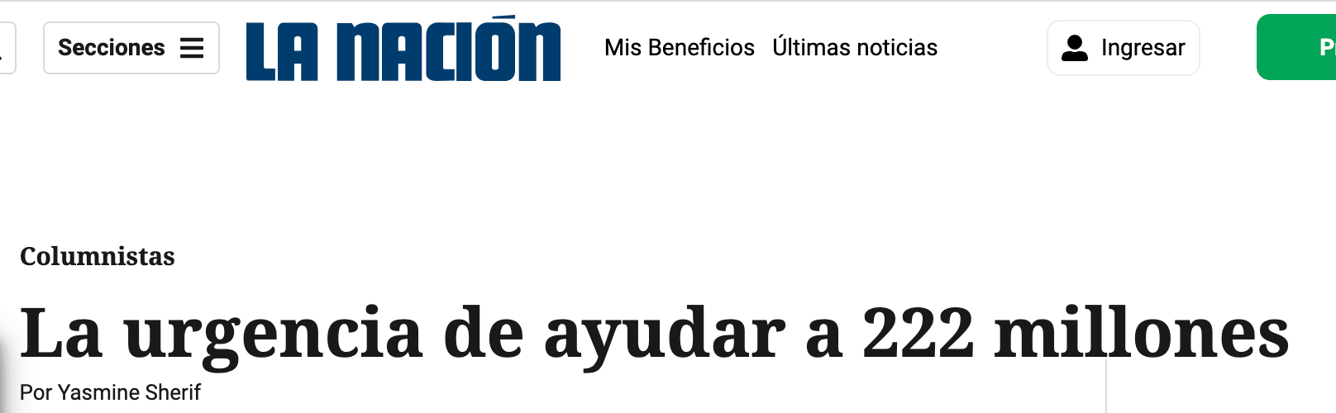

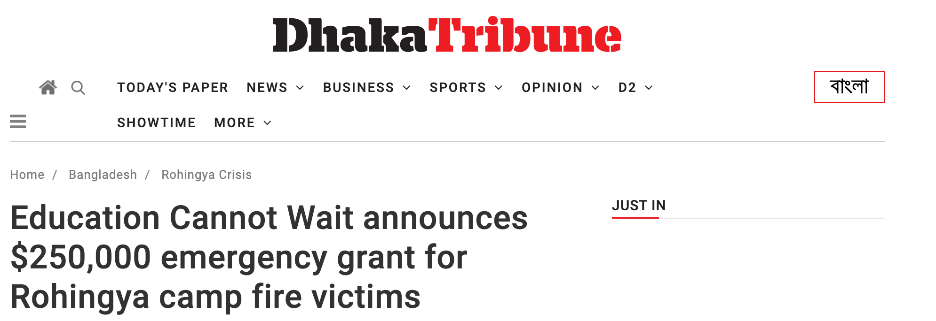
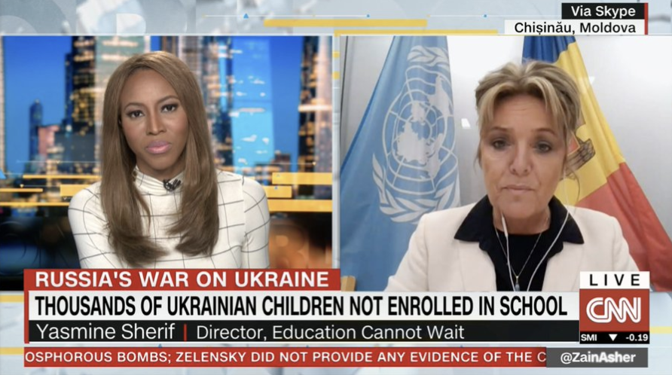

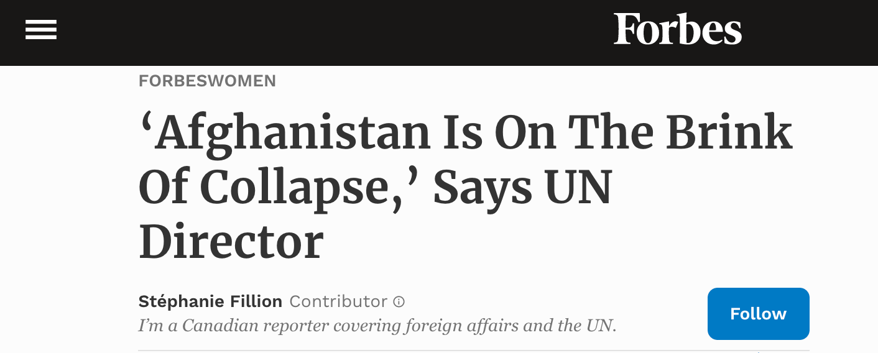
#222MillionDreams #HLFC2023
External Media
Media Engagement and ECW Mentions
Communication & media outreach opportunities (global & national launch, in-country programme events, high level field visits)
Cross-promotion of messages to respective audiences
(global – regional – national)
Media partnerships
(IPS, Factstory/AFP, Global Citizen)
11

Slide 12
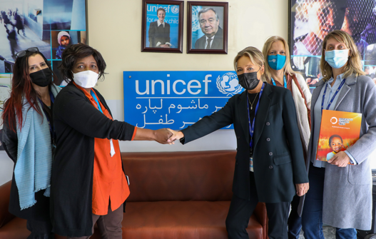
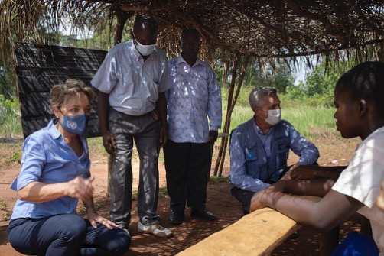
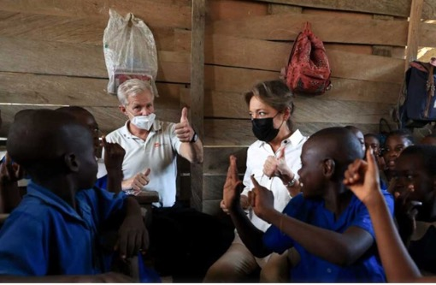
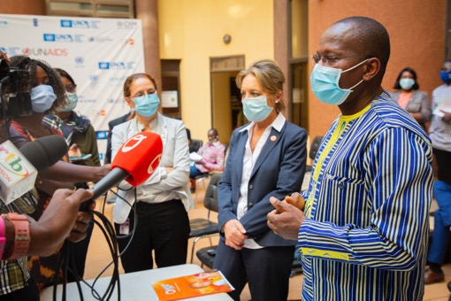
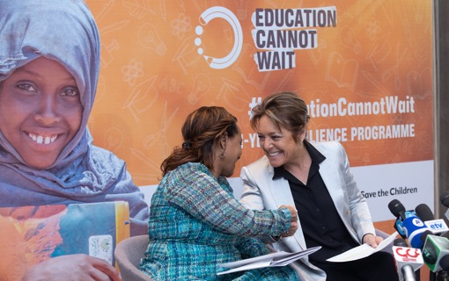

#222MillionDreams #HLFC2023
ECW Missions
Afghanistan
DRC
Cameroon
Today
Burkina Faso
Ethiopia
Lebanon
12

Slide 13


Human Stories
Steps to Getting
Stories on ECW Channels
1. Share story with ECW's Advocacy and Comms Team
(stories@un-ecw.org)
2. ECW reviews story to ensure it contains, at a minimum:
(1) accompanying photos/visual assets
(2) human elements such as beneficiary quotes
(3) mention of ECW funding/investment
3. ECW uses shared story assets (text, photos, captions, etc.) to create story on Exposure platform and ECW website.
4. Newly published story, which also links back to Partner's original story, is shared and promoted across ECW channels!
Today
13
Notes:
(Jelena Leading)
Mention ECW's Exposure Page (which gets 50k views each month) and stories featured on ECW website… Browse past stories, mention IPS partnership

Slide 14


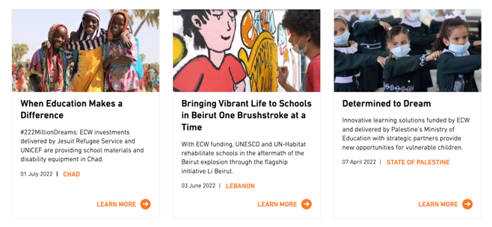
#222MillionDreams #HLFC2023
Human Stories Tip Sheet
Recommendations
Please send your story:
stories@un-ecw.org
Human Element is KEY – stories should feature beneficiaries and include quotes
High-resolution landscape photos (especially of beneficiaries who are quoted in text) with captions clearly detailing who is in photos, context of shot and photo credit
Videos: landscape and max. 2 minutes (unless documentary)
Under 800 words (short, simple and clear)
Today
Tag @EduCannotWait when you post on your social channels so that we can amplify the story! We will do the same when we publish stories shared with us.
Be featured on educationcannotwait.org!
How many stories should partners share?
At least 1 per quarter, including
accompanying high-res photos
*Note on Ethical Imagery: No child/beneficiary should be put at risk to tell a story – protect names and identities when needed (see Visibility Guidance Note for more info)
14
Notes:
(Jelena Leading)
CHECKLIST
importance of high-res photos + visual assets (high-resolution, when possible, clear photo credits, etc.)
videos
Quotes from beneficiaries/partners (with accompanying photo)
ECW investment mention
Call for Stories – stress that we will provide visibility on the new ECW website (human stories page and country pages) as well as on our social channels.
Mention the stories@un-ecw.org email address for submitting potential stories + visual assets to ECW Comms Team.
Ethical Imagery Reminder (refer to Visibility Guidance Note)

Slide 15









#222MillionDreams #HLFC2023
Social Media
ECW’s Channels
Main Accounts
ECW Recommendations
educationcannotwait.org
@EduCannotWait
+64K followers
1. We encourage grantees to…
@EduCannotWait
@KentPage
+111K followers
Follow ECW social media channels.
Publish posts showcasing your work & results with ECW funding (4x/month)
/EduCannotWait
@YasmineSherif
+13K followers
/EducationCannotWait
Retweet/share and like our posts.
@EduCannotWait
Main Hashtags #
2. Contact the ECW Advocacy/Comms Team
ecw.exposure.co
#222MillionDreams✨
Don’t hesitate to contact us with any significant social media campaigns so we can promote and amplify.
#EducationCannotWait
/ECWEducationCannotWait
#ECW
#SDG4📚
3. Join ECW Campaigns
/EduCannotWait
!
ECW regularly launches online campaigns to advocate for EiEPC and the children we serve. We develop and share social media kits with engaging messages + graphics + templates that you can customize for your social accounts!
@EduCannotWait
Make sure to tag our accounts and use key #
/EduCannotWait

Slide 16
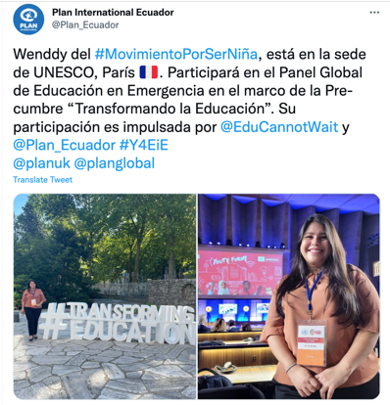
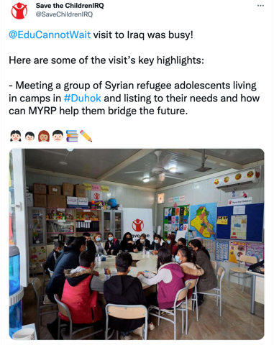




#222MillionDreams #HLFC2023
Social Media
16

Slide 17






ECW Brand Guidelines
#222MillionDreams #HLFC2023
17

Slide 18


ECW Brand Guidelines
#222MillionDreams #HLFC2023
Download here
18

Slide 19
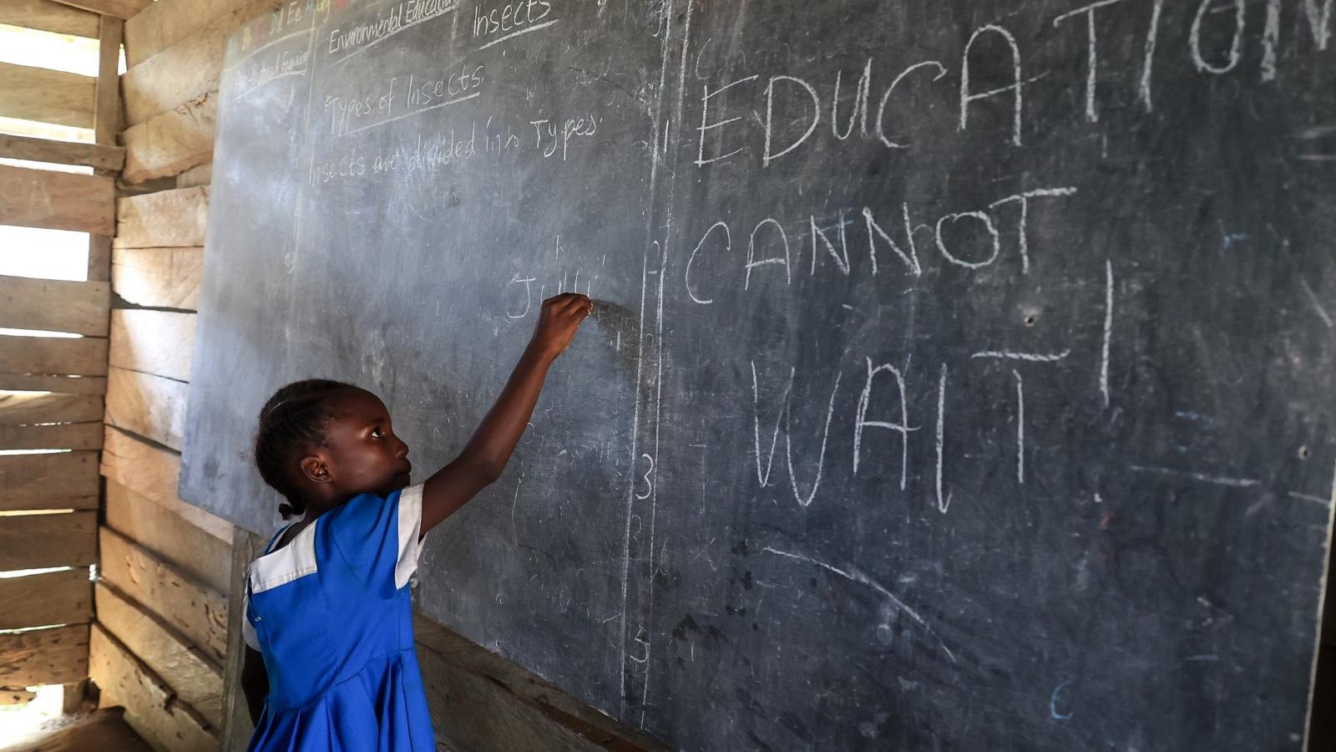

#222MillionDreams Cannot Wait
@EduCannotWait
/EduCannotWait
@EduCannotWait
@EduCannotWait
Education Cannot Wait
Education Cannot Wait

